Slide 1

ALI UYSAL
FACTORS OF A SUCCESSFUL
PROJECT

Slide 2
Agenda:
Data
Motivation
Analysis
Findings
Further Research

Slide 3

> 400.000 Projects
5.000 Projects Scraped using Scrapy
28 attributes
US Only!
Cancelled projects eliminated

Slide 4
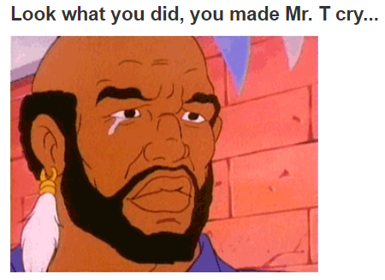
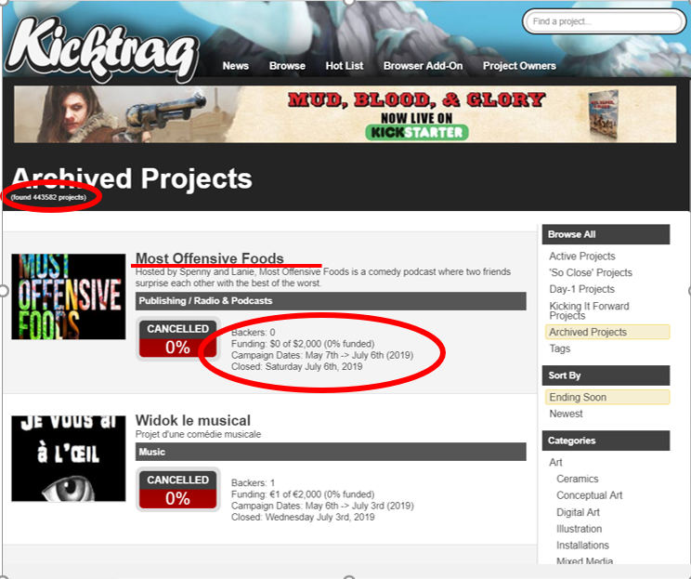
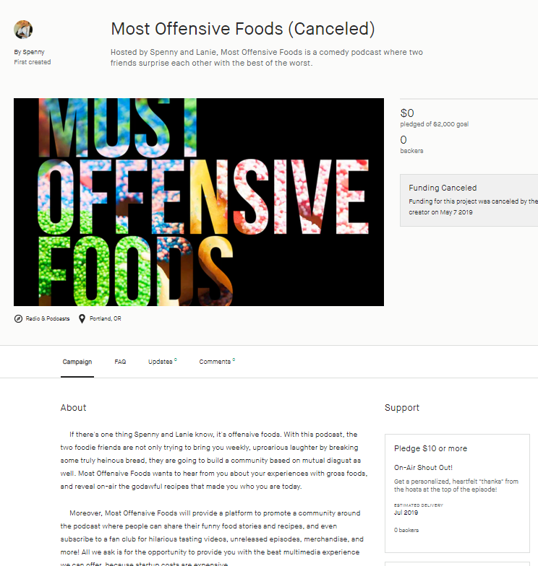
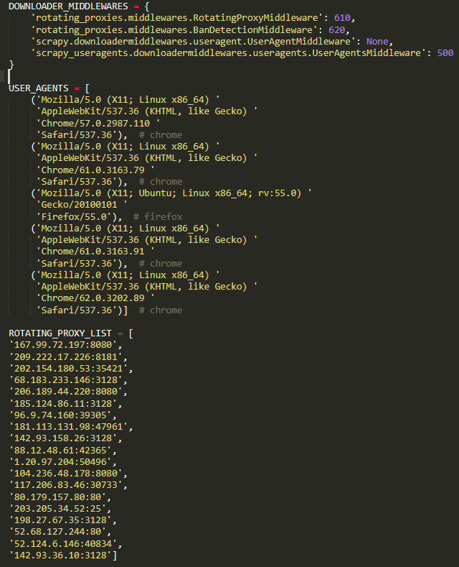
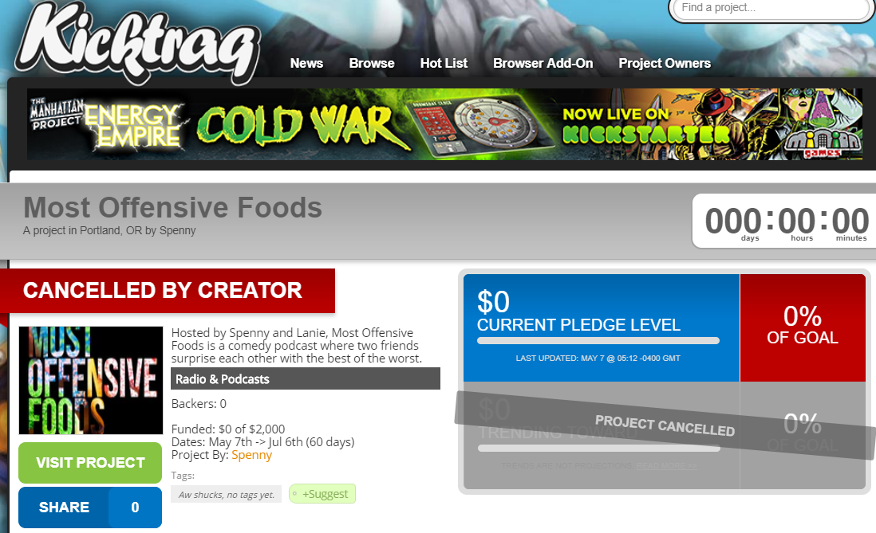

Slide 5
Motivation
Most successful project categories/US States?
Factors of a successful project?
Campaign duration
Funding goal
Image/Video
# of FAQs
# of Updates

Slide 6

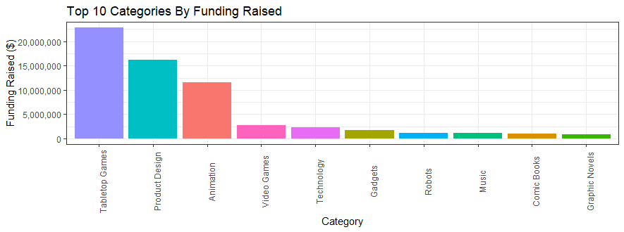










by numbers

Slide 7
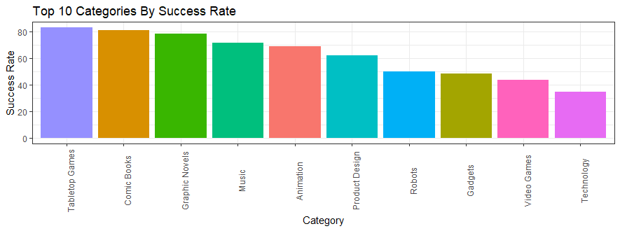
by numbers

Slide 8
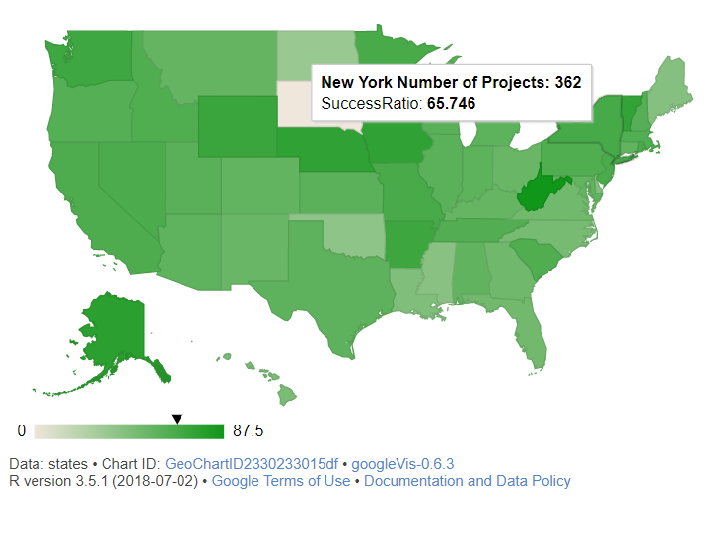
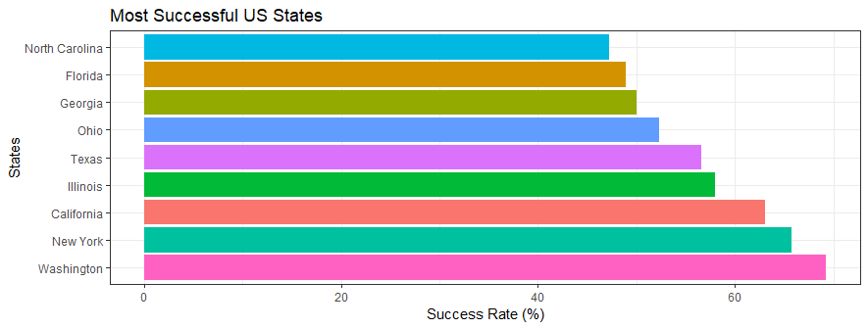
by states
Success rate by states
# of projects by states

Slide 9
What are the factors affecting the success of a project?

Slide 10
$ 9.190
$ 43.085
AVERAGE FUNDING GOAL
$ 33.857
$ 1.529
AVERAGE FUNDING RAISED
74.49
1.64
AVERAGE # of COMMENTS
7.34
1.42
AVERAGE # of UPDATES
14.60
5.48
AVERAGE # of PROJECT IMAGE
SUCCESSFUL
UNSUCCESSFUL

Slide 11
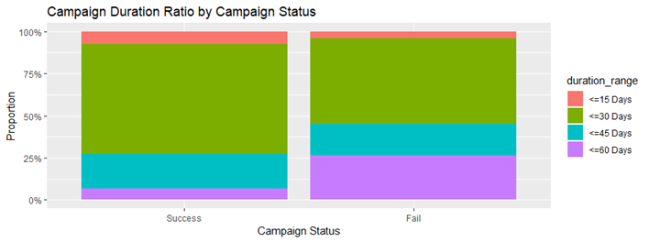
Projects with 60 days of campaign duration are more likely to fail!

Slide 12
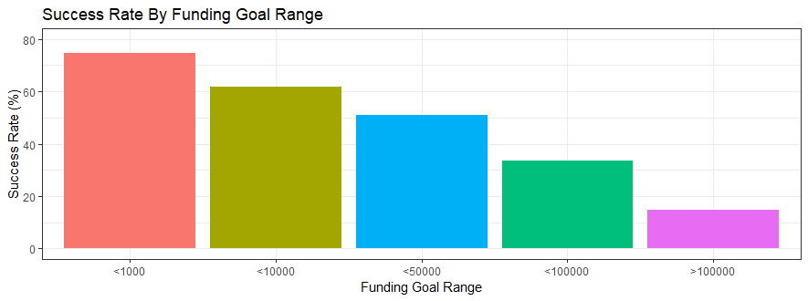
The higher the goal range of a project, the lower the success rate is!

Slide 13
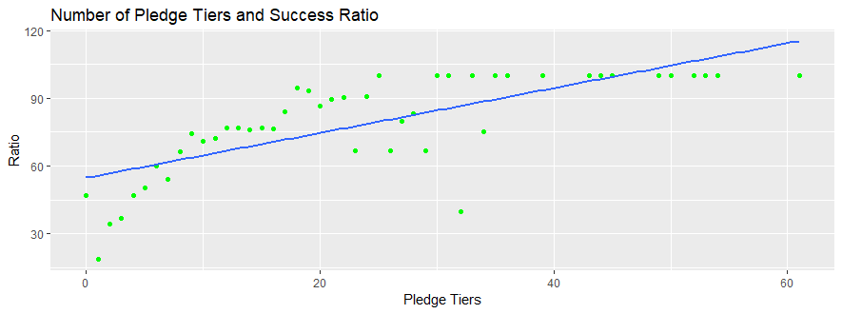
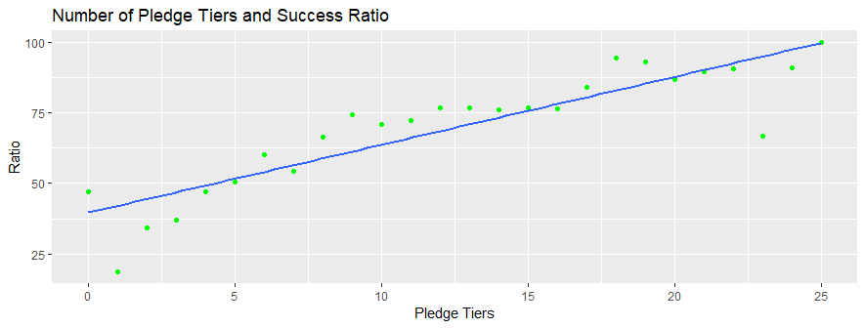
Number of pledge tiers up to 20-25 increases success rate!

Slide 14
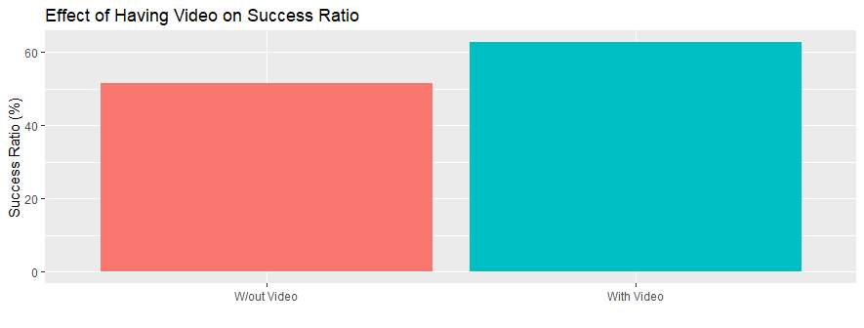
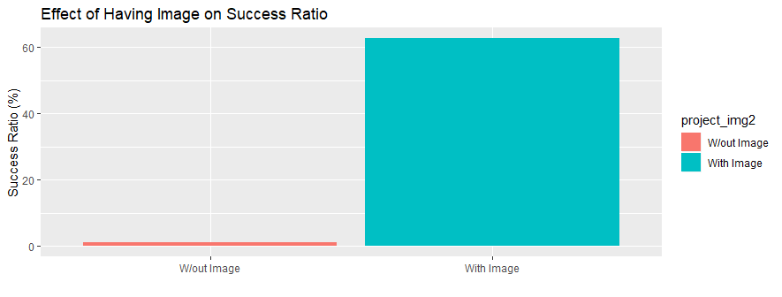
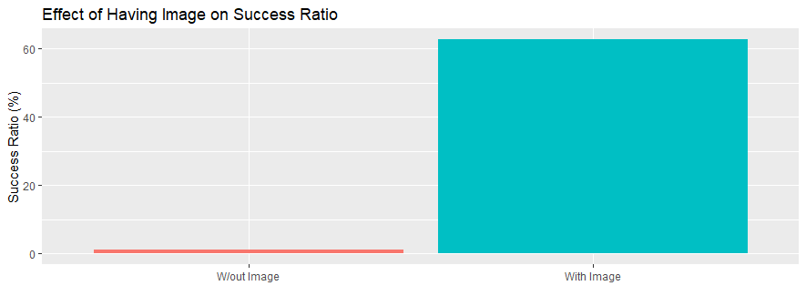
Image/Video Effect On Project Success
Video 15% up
Image 60% up

Slide 15
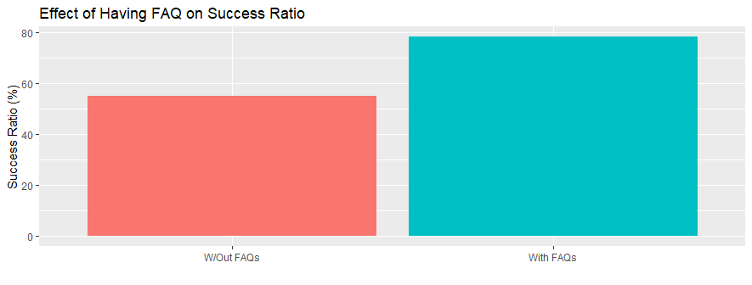
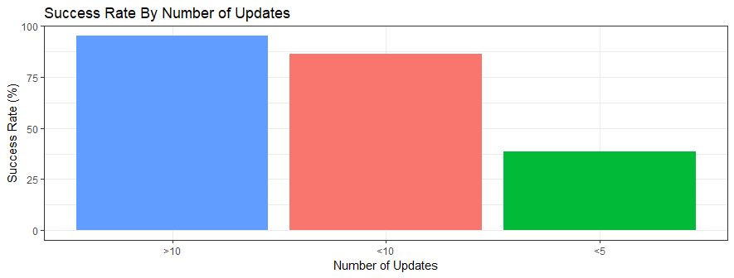
FAQs / Updates Effect On Project Success
24% increase in success chance
5 to 10 -> Double success chance
>10 -> Positive effect slows

Slide 16
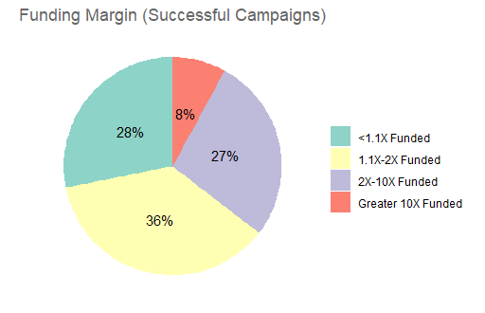
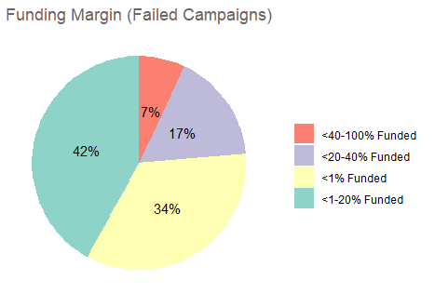
Funding Margins by Project Status
- One third just a bit over goal
- More than half did very well
- Over-achievers 8%
- More than 90% of failed projects can not even reach 50% of their goal!

Slide 17
Conclusion
To launch a successful campaign;
Duration <= 30 days. Do not choose the maximum of 60 days.
The smaller the goal, the higher the success rate.
Number of pledge tiers up to 25 increases chances of success.
Having video has positive effect.
Images have huge impact.

Slide 18
Further Research
Most popular pledge tier
Applying Multiple Linear Regression
Predicting The Probability Of Success

